Slide 1
Acme Sprocket Company
Back-End Lesson #3-
Data Access Layer,
H2,
Custom Exceptions,
Mocking
Notes:
Talk about:
The plan to move to a multi-module project
Parent pom –> SLN file (solution file)
Reiterate – Java annotations are a big part of Spring
Seems more annotation-heavy than C#
Go through files and compare
Response Entity -> IActionResult
Routing = the same
Validation -> attribute
Request variable, path variables seem similar
Naming convention of the Interface/ServiceImpl
Mocking – when we add the persistence layer
Lesson 3
Overview: Data access layer
Repositories
H2 in-memory database
Custom Exception Handling
Mocking/unit-testing

Slide 2
Back-End Lesson 3 Plan Code Demo Questions For Further Reading Next Session
Agenda
Notes:
TODO:
Complete unit tests
Mock persistence layer in testing
Project structure: parent project with sub-projects (or modules)

Slide 3
Data Access Layer H2 database Exception Handling Mocking in Unit Tests
Back-End Lesson 3 Plan

Slide 4
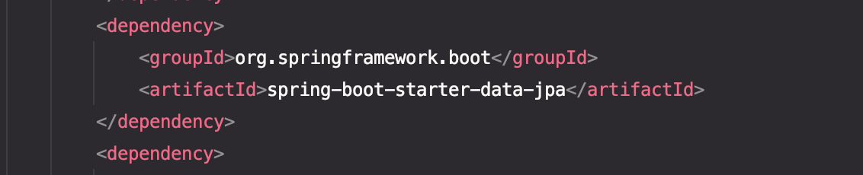
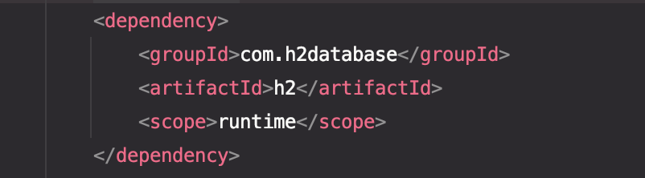
Data Access - add to pom.xml: Spring JPA
H2 db

Slide 5
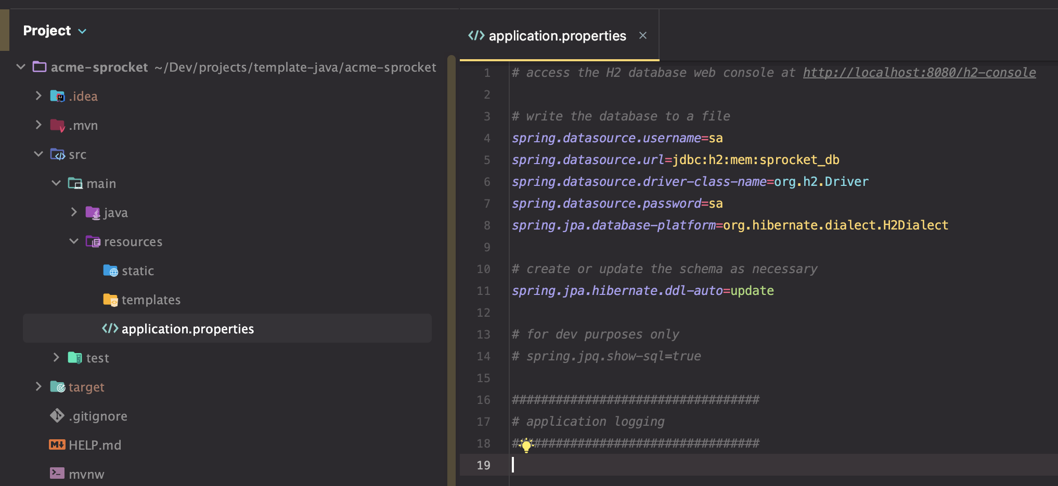
H2 Configuration:

Slide 6
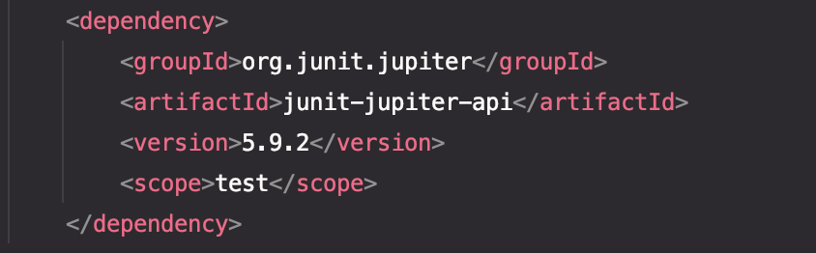
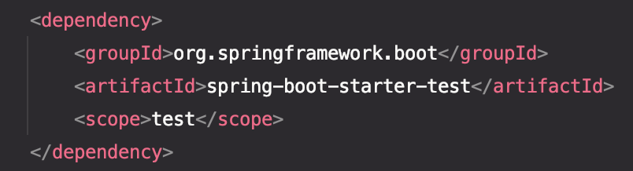
Unit Testing and Mocking

Slide 7
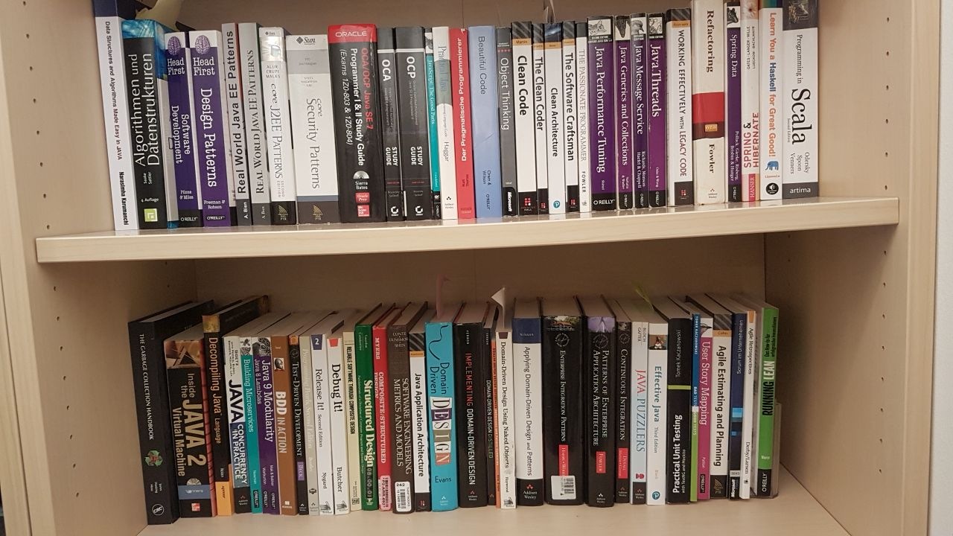
Code Demo
Notes:
https://twitter.com/unclebobmartin/status/1517554583089958914

Slide 8
Questions?

Slide 9
Spring Boot project in GitHub LINK “A Guide to JPA with Spring” LINK “Spring Boot with H2 Database” LINK “Error Handling for REST with Spring” LINK
For Further Reading…
Notes:
https://www.baeldung.com/exception-handling-for-rest-with-spring

Slide 10
Front-End Lesson 3: Finish project configuration Routing options Deploying to Azure Back-End Lesson 4: Hierarchical project structure Domain in respects to Sprockets Domain Objects, Validation Testing: Update for domain stuff CI/CD: deploy
Next Sessions

Slide 11
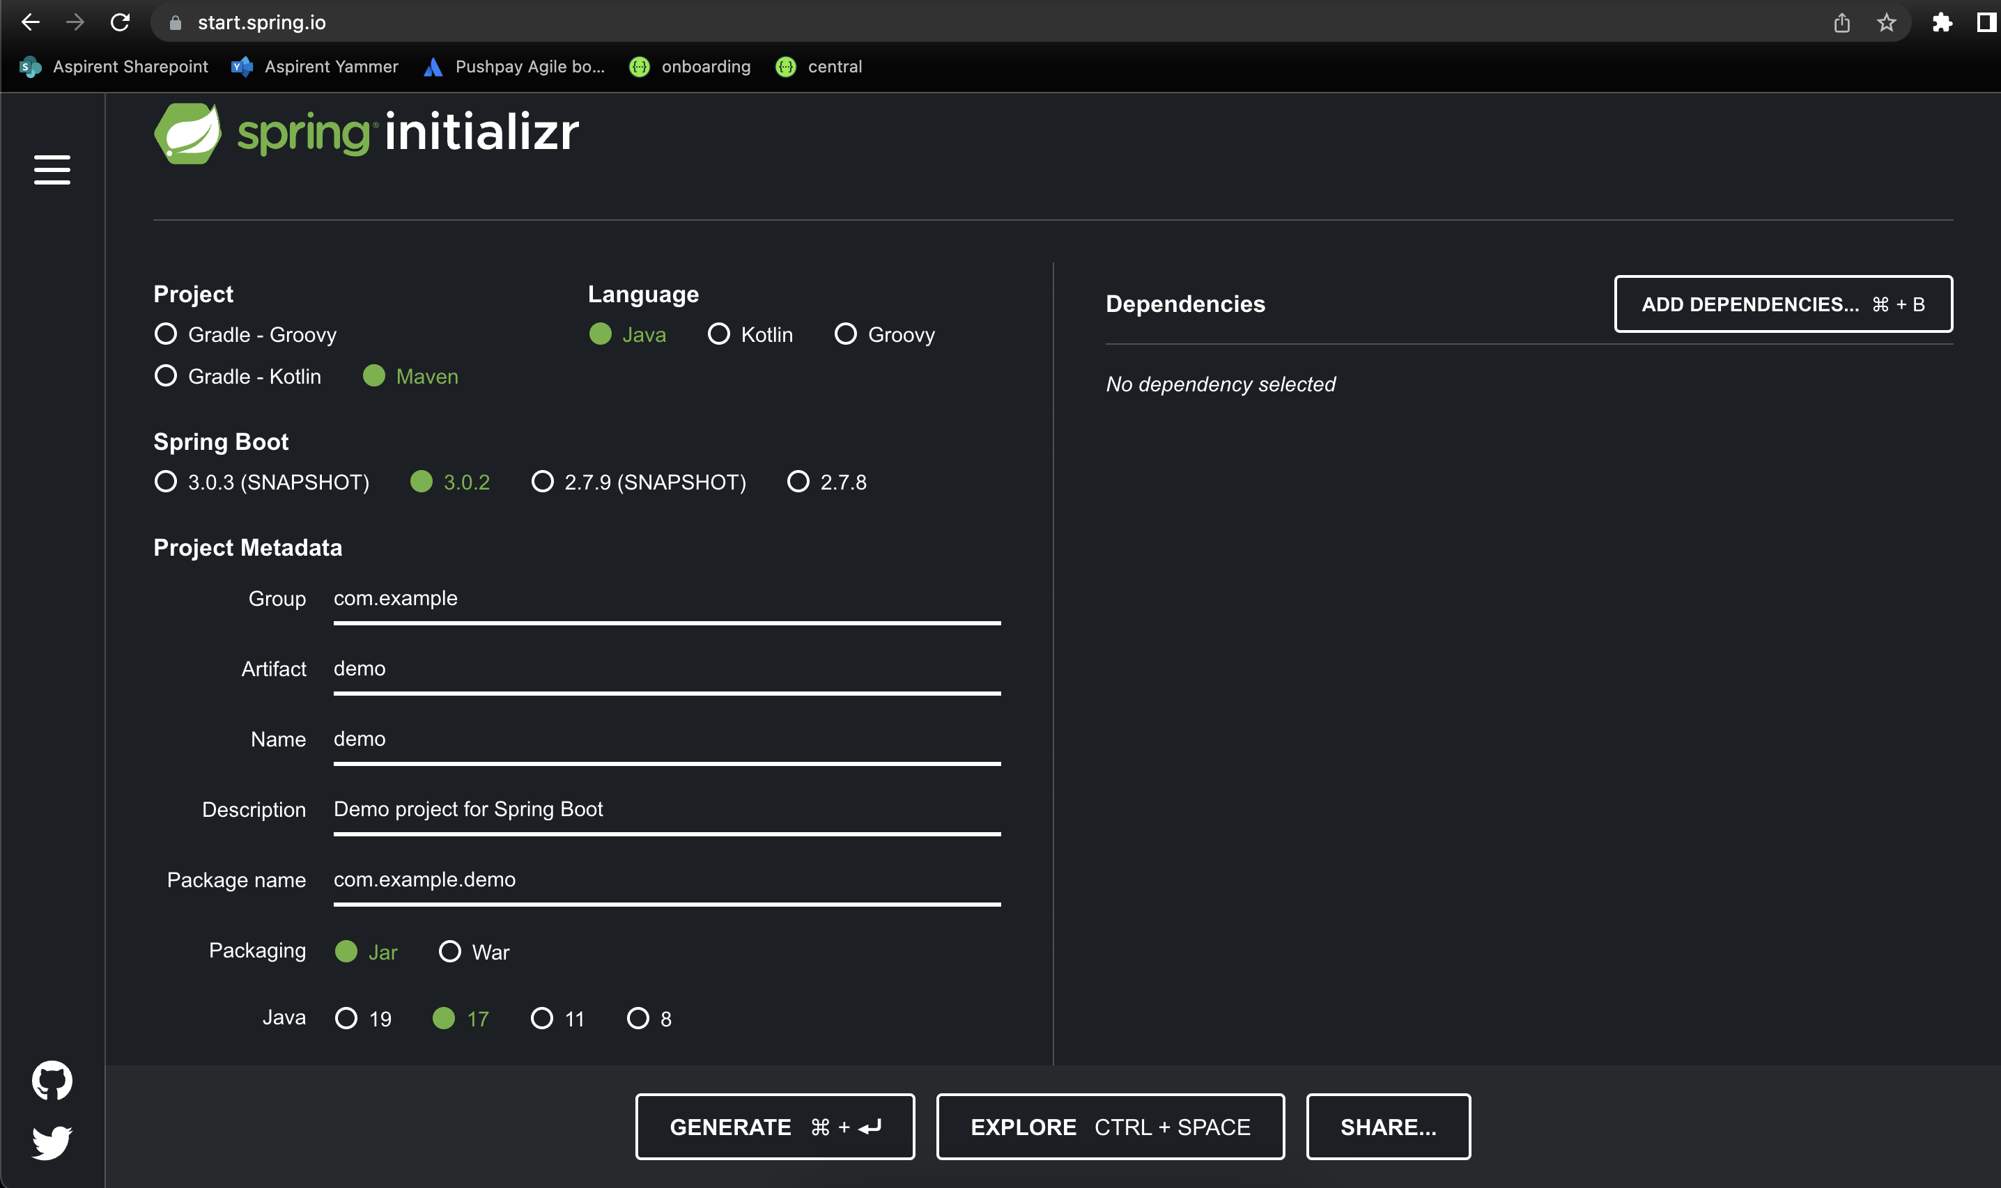
How Do I get started with Spring Boot?
Spring provides a website to create and download preconfigured and working empty projects to get you started quickly!
https://start.spring.io/

Slide 12
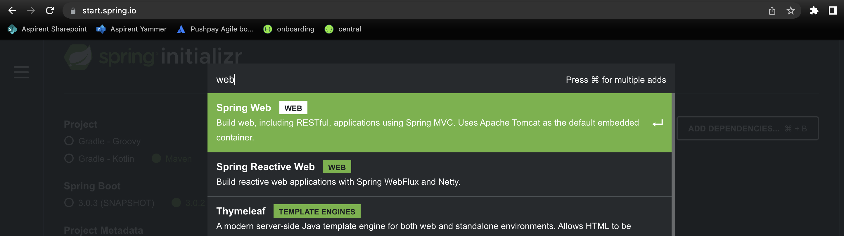
Creating an empty REST controller project
As simple as going to start.spring.io and searching for the “web” dependency!

Slide 13
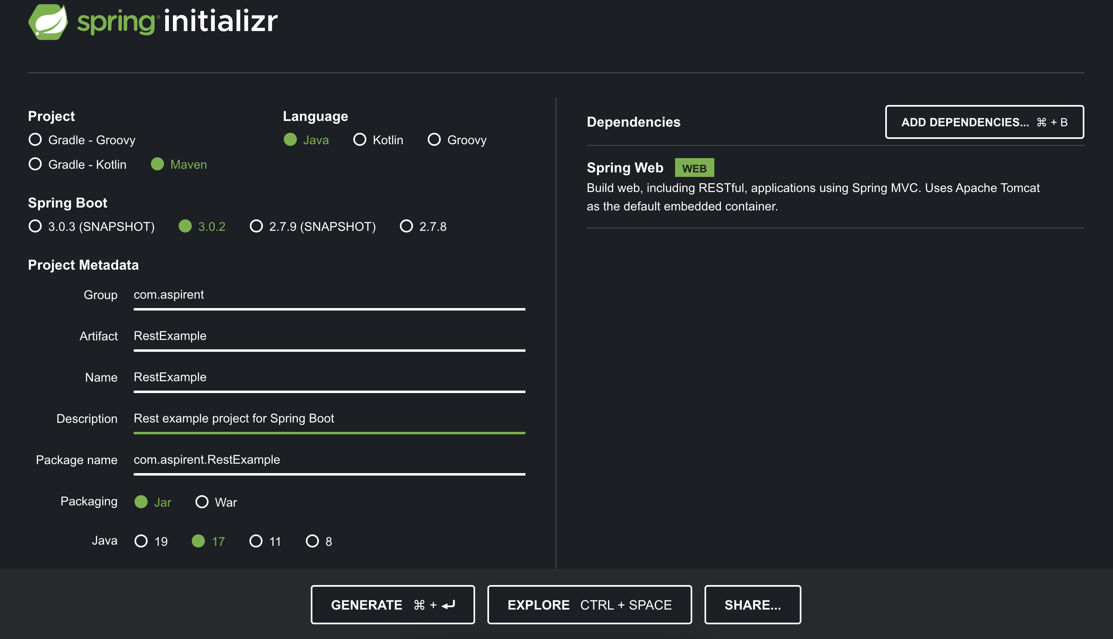
Generating an empty REST controller project

Slide 14
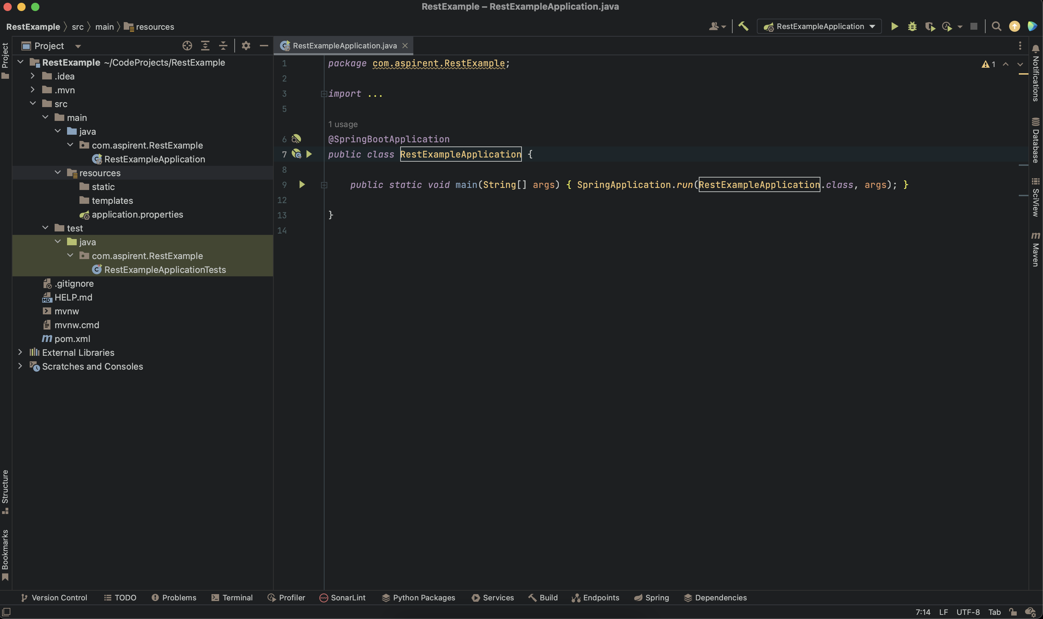
What does the newly downloaded zip file include?

Slide 15
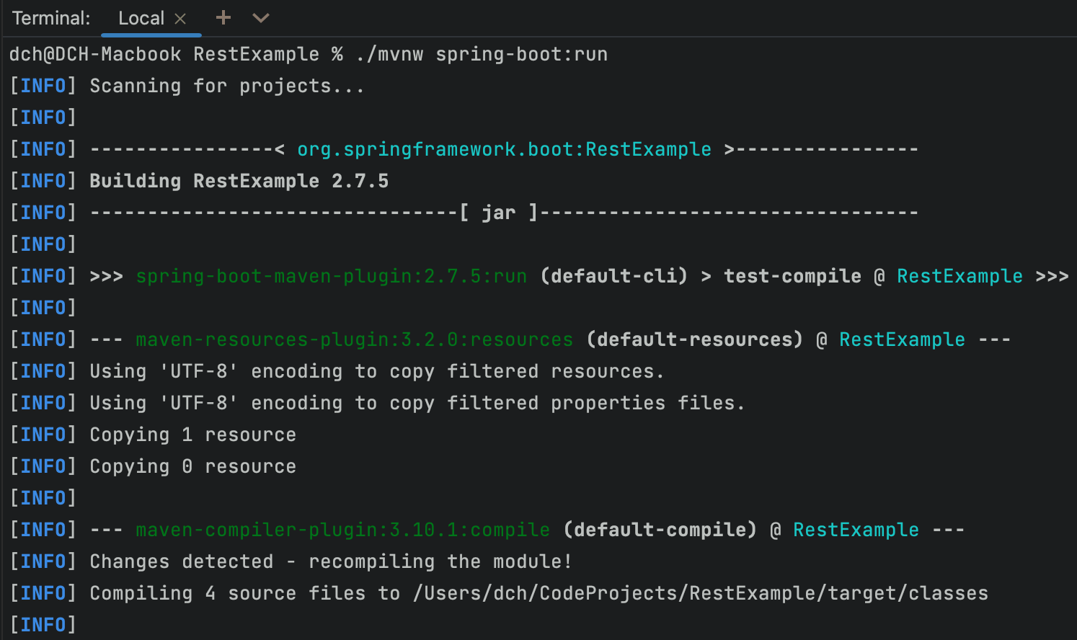
Since we’re using Maven we’ll run the app through the the maven wrapper:
How to run the newly generated project:
./mvnw spring-boot:run

Slide 16
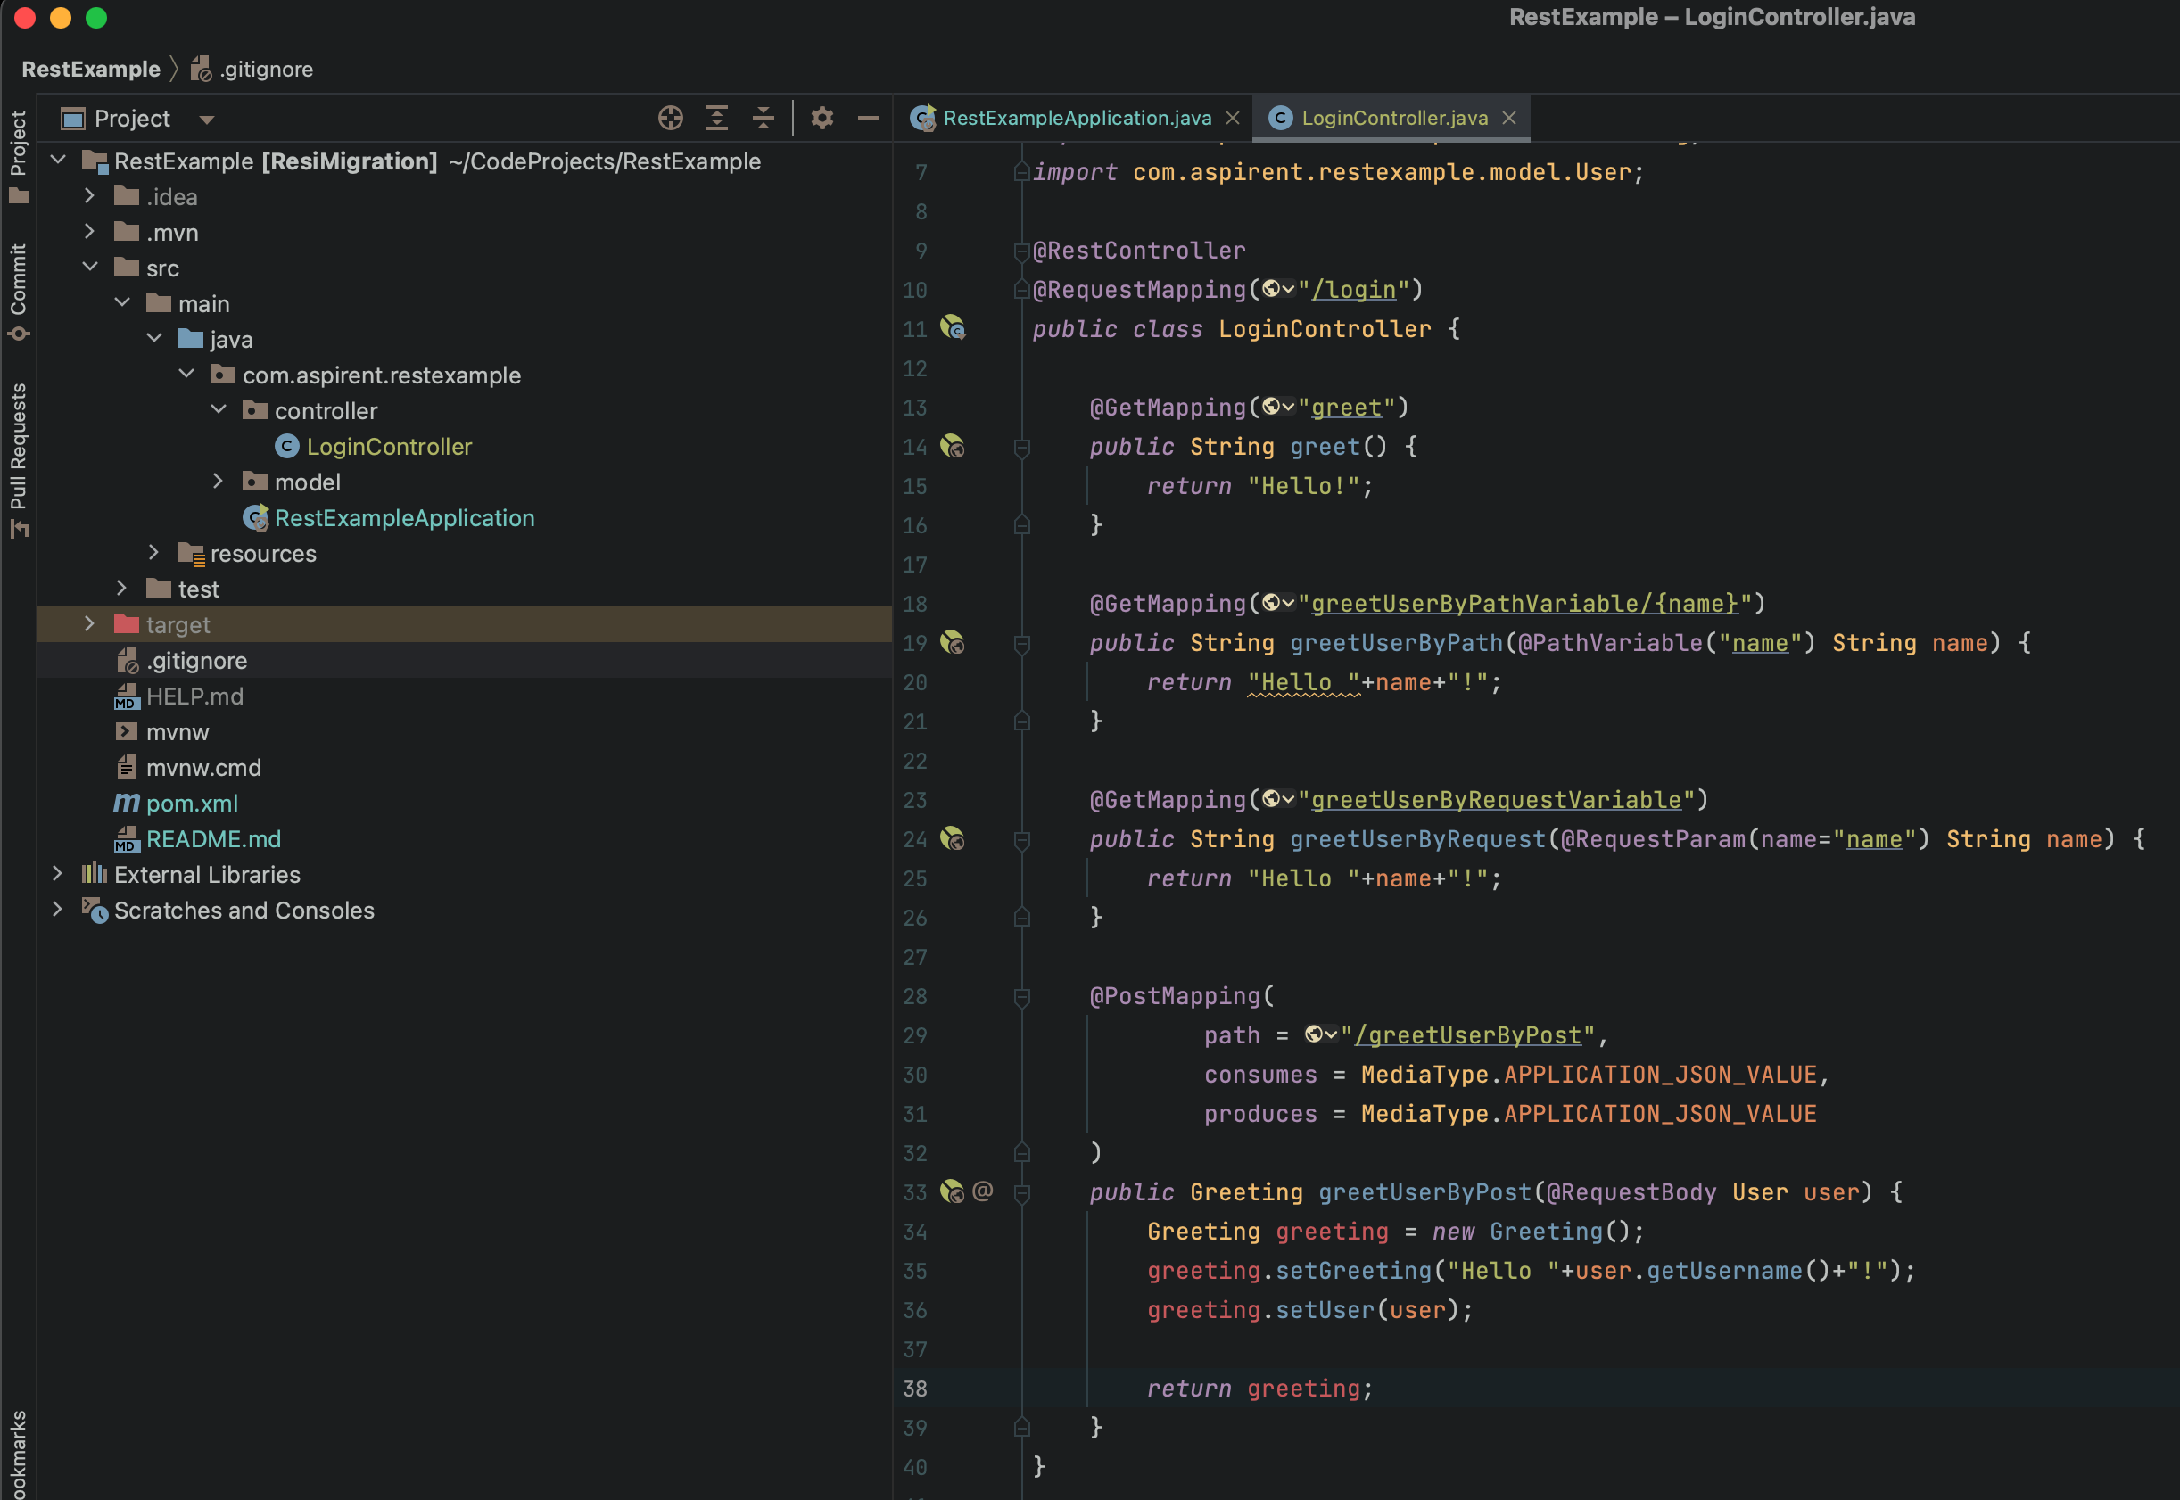
Create a basic Controller class:

Slide 17
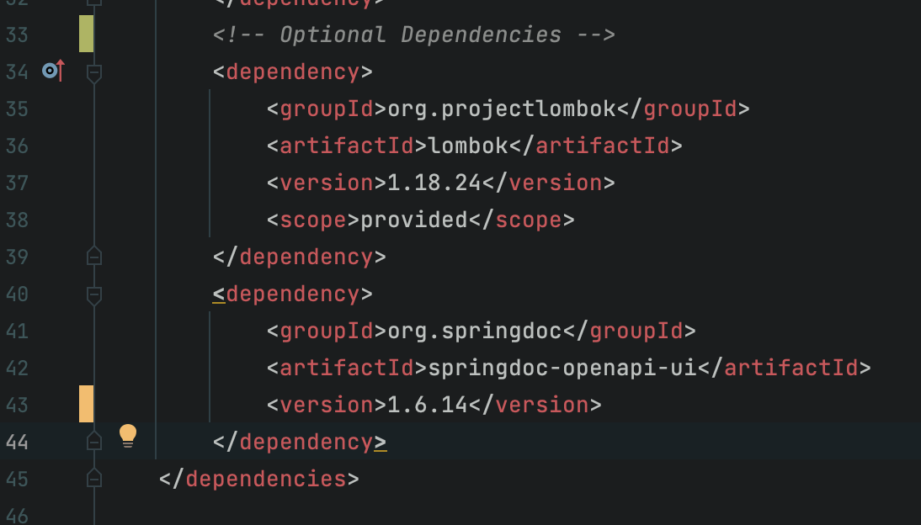
Since we’re using Maven we add the two libraries to our pom.xml
Let’s add Swagger and Lombok:

Slide 18
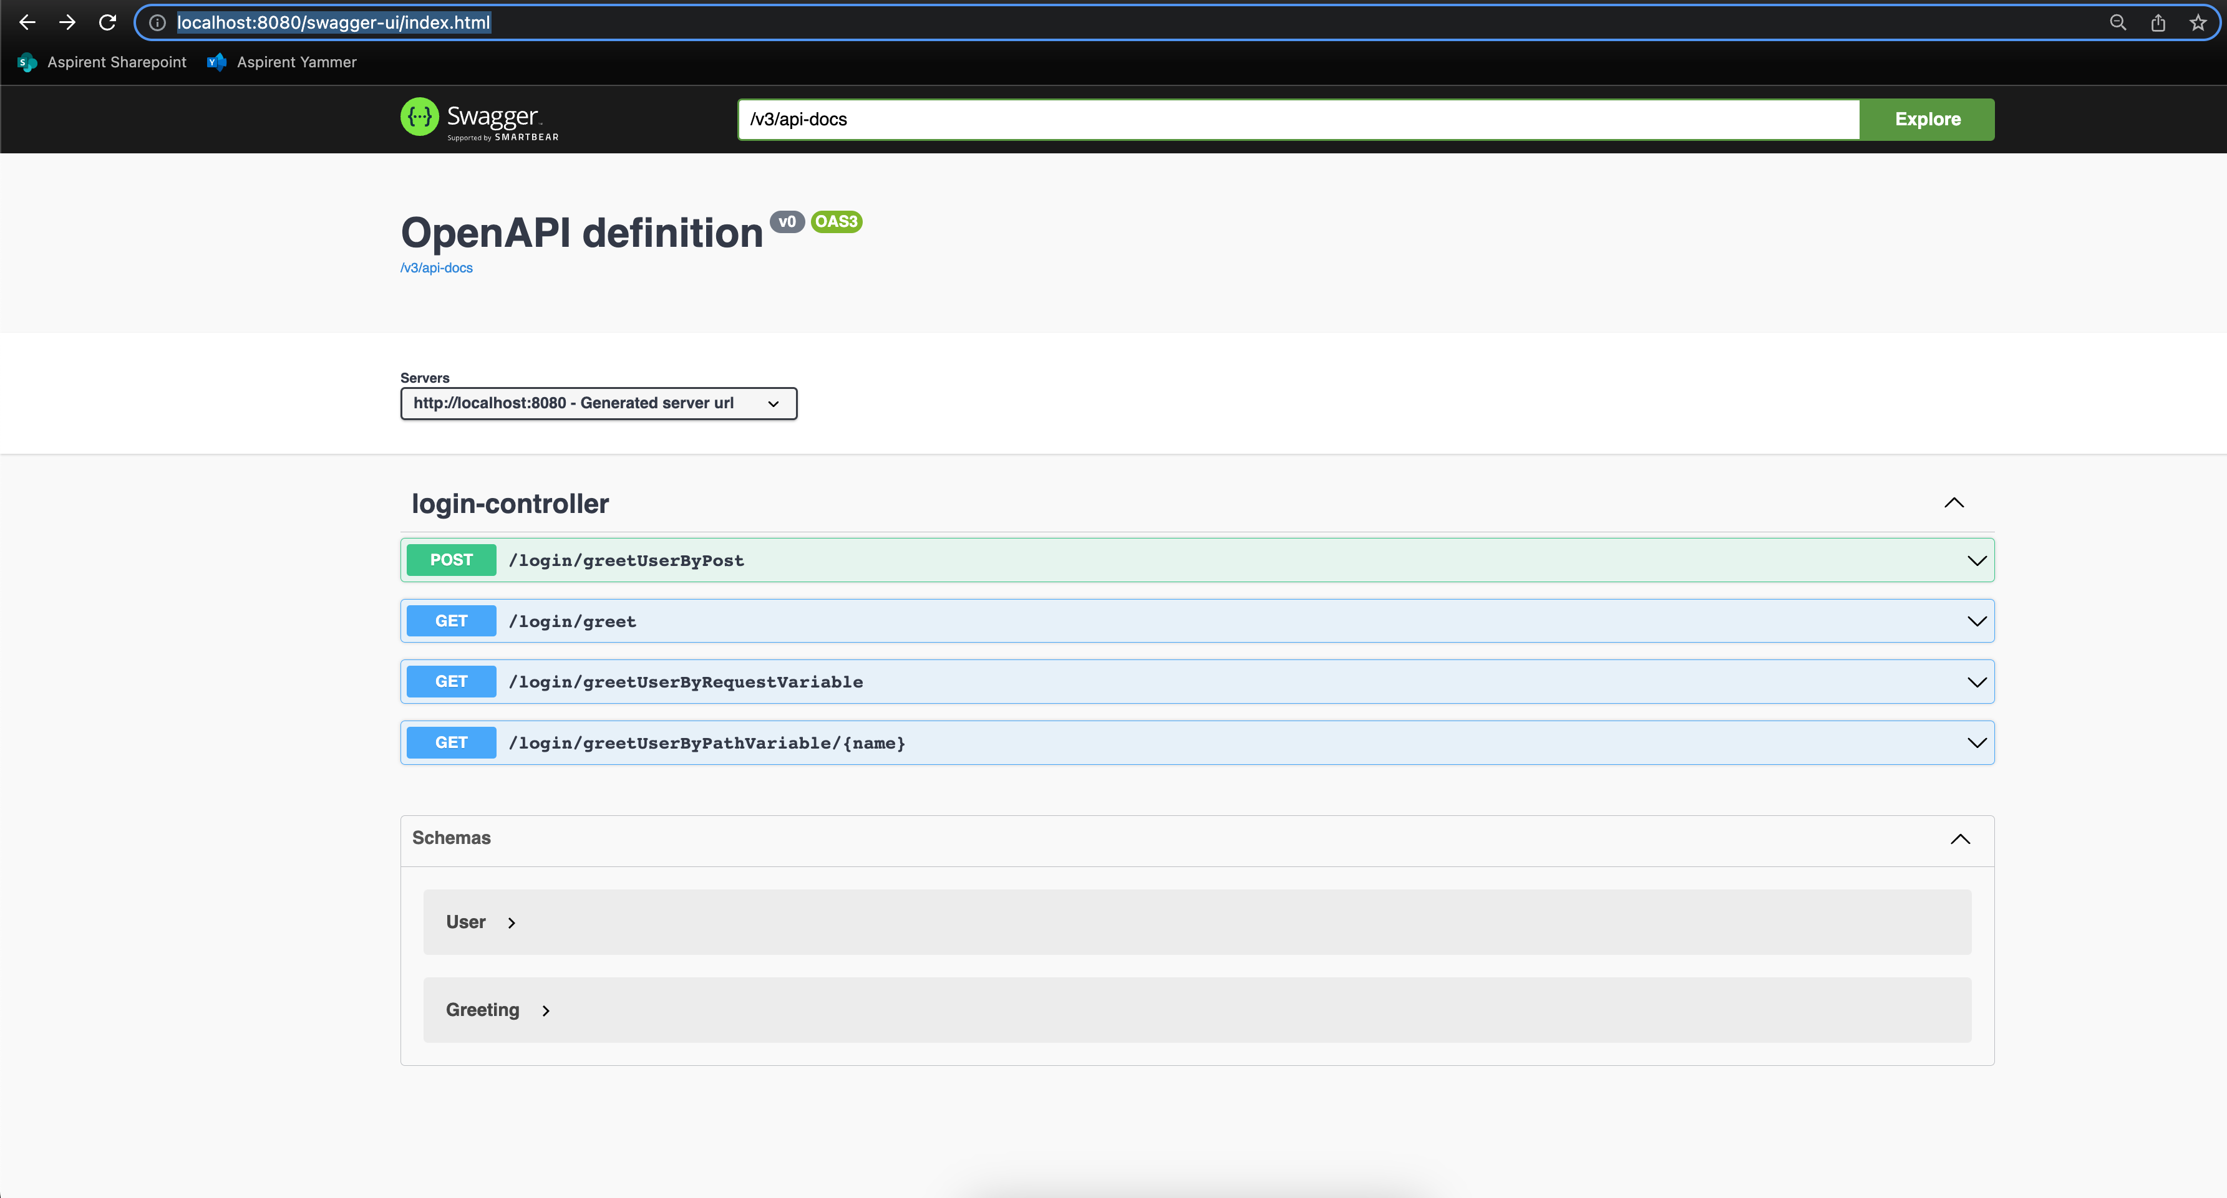
Navigate to: http://localhost:8080/swagger-ui/index.html
What does Swagger give us:

Slide 19
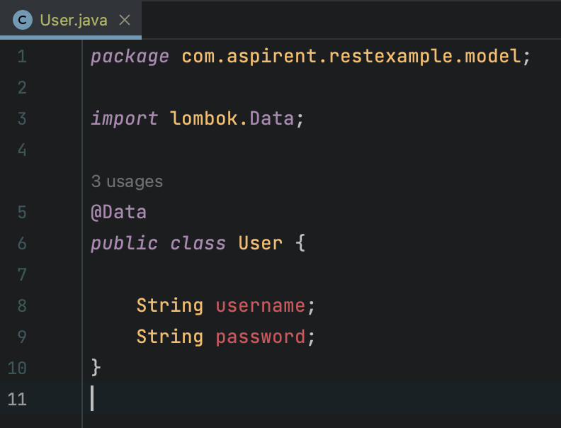
Automatic getter and setter creation:
What does Lombak give us:

Slide 20
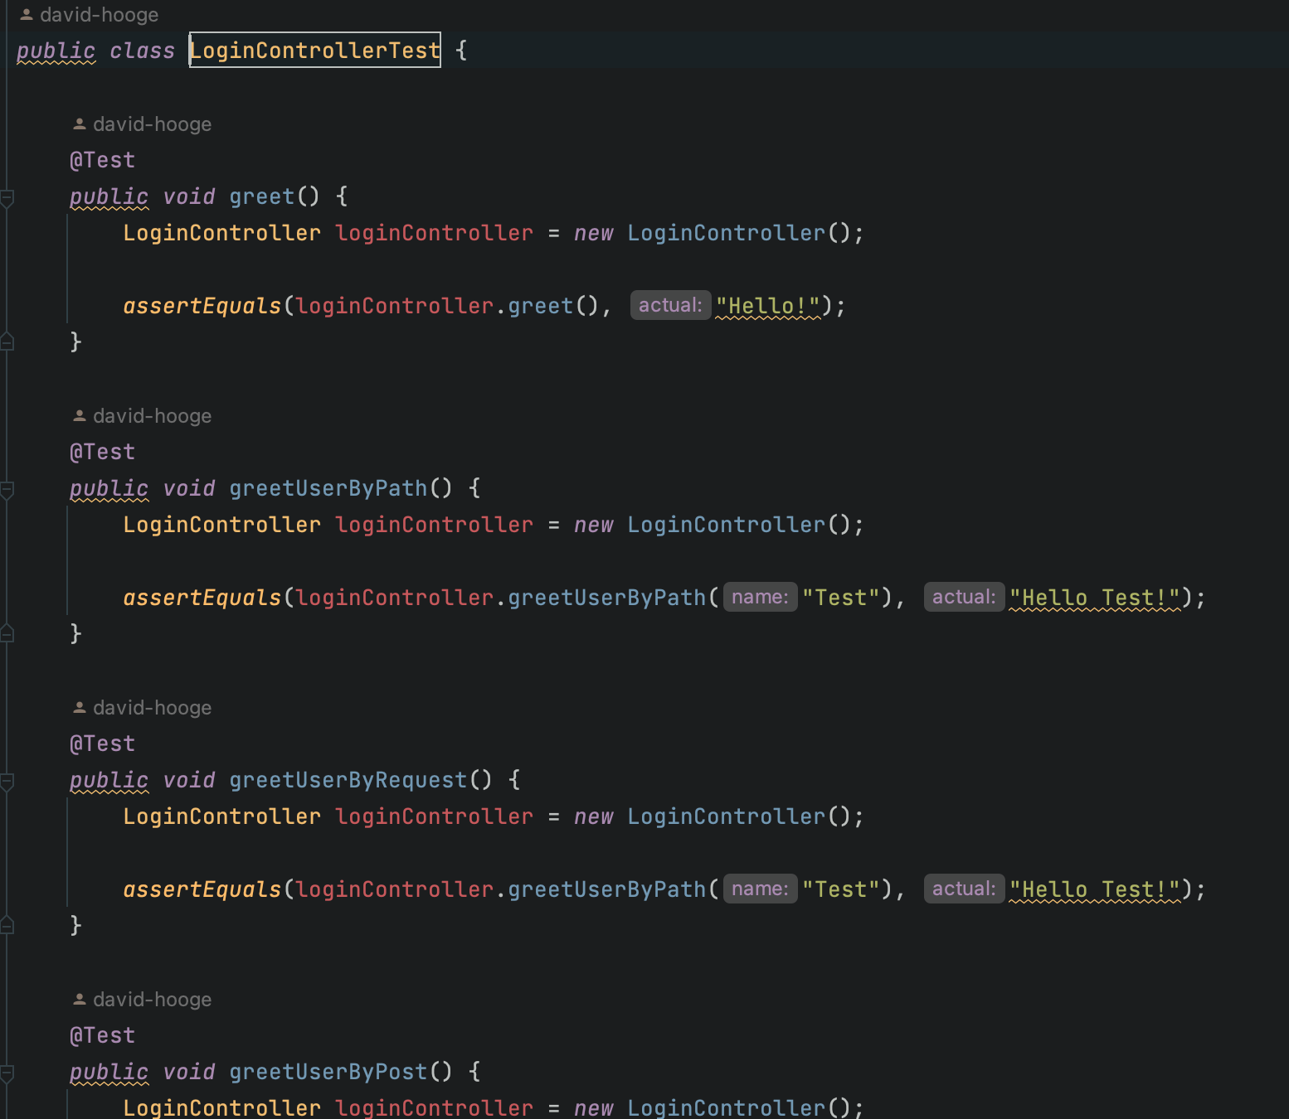
Add testing code:
Adding Unit Testing

Slide 21
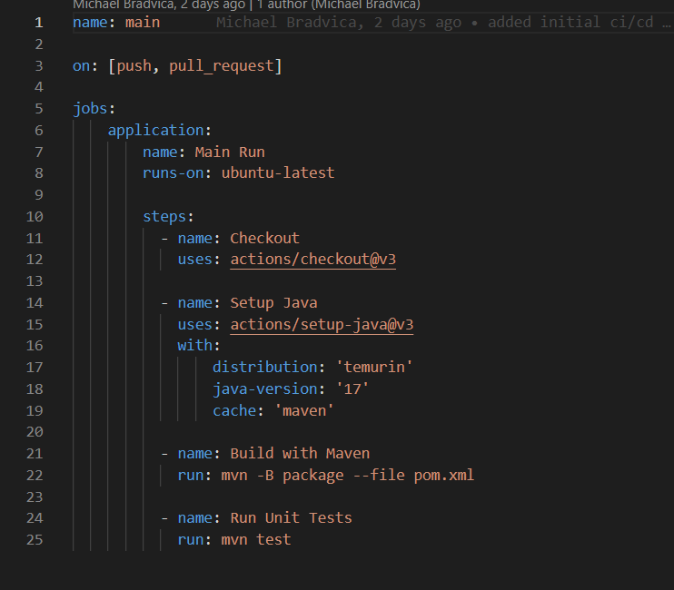
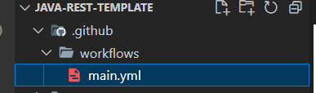
CI/CD for Java
CI/CD for Java follows the same fundamentals as our front-end config
The biggest differences are the commands needed-but the structure is the same

